Slide 1



INFORMATION SECURITY ANALYST — GIZA_ISS6_S1
Zero Trust Architecture Lab
A Dual-Site, Multi-VM Security Engineering Case Study
Karim Abdel-Nasser Rady · Mohamed Mamdouh · Donia Abd Elnasser Mohamed
Hoda Khaled Essam Eldin Mansour · Ali Ashraf Ali Mehanna · Mohamed Adel
Supervised by Eng. Mohamed Seed

Slide 2








ROADMAP
What We'll Cover
01
02
03
04
Project Overview
Foundations
Requirements
Architecture
Proposal, plan, team roles & KPIs
Zero Trust theory & literature review
Stakeholders, use cases, FRs / NFRs
VMs, VLANs, segmentation & firewall policy
05
06
07
08
Access Control
Telemetry & SIEM
Attack Simulation
Validation & Results
Cloudflare · Traefik · Authelia (3 layers)
Vector pipeline, noise reduction, enrichment
Kill-chain & MITRE ATT&CK mapping
Testing, metrics, lessons, what's next
ZTA Lab — Graduation Project
2

Slide 3

SECTION 1 · PLANNING
Project Proposal & Scope
A Zero Trust Architecture (ZTA) security lab spanning two physical machines and eight virtual machines, built around NIST SP 800-207. No device or user is trusted based on network location alone — every access request is authenticated, authorized, and logged regardless of origin.
Identity-Aware Access
Cloudflare Edge · Traefik · Authelia
Network Segmentation
4 VLANs enforced by pfSense
Project Plan — Four Phases
Telemetry Engineering
Vector + Splunk pipeline
Phase 1
Phase 2
Phase 3
Phase 4
Infrastructure Setup
Access Control
Telemetry Pipeline
Detection Engineering
Detection & Validation
>
>
SPL rules mapped to MITRE ATT&CK
>
pfSense, Suricata, 8 VMs, VLAN tagging
Traefik, Authelia, cloudflared tunnel
Vector both sites, IPsec tunnel, Splunk HEC
SPL rules, kill-chain script, testing
ZTA Lab — Graduation Project
3

Slide 4
SECTION 1 · PLANNING
Team Roles & Key Performance Indicators
6-Member Engineering Team
Key Performance Indicators
Network & Segmentation — pfSense, VLAN design, IPsec, firewall policy
Access Control — Traefik routing, Authelia MFA, Cloudflare WAF
Telemetry Engineering — Vector pipeline design, Splunk HEC integration
Detection Engineering — SPL rules, MITRE ATT&CK mapping, SOC dashboard
Attack Simulation — Kali kill-chain script & attack documentation
Documentation & Validation — Architecture docs, screenshots, results
3 layers
85%
7 sources
14
10
Independent access enforcement
Log volume reduction via filtering
Telemetry integrated into Splunk
MITRE ATT&CK techniques covered
Prototype detection rules
Geo / device-posture enforcement
Access from a non-permitted country or unenrolled device is rejected at the edge — confirmed: HTTP 403 returned before reaching Traefik.
Cross-VLAN containment
Untrusted zone (VLAN 40) blocked from management & services zones — confirmed in functional validation (connection timeout).
ZTA Lab — Graduation Project
4

Slide 5



SECTION 2 · FOUNDATIONS
Literature Review
Zero Trust Architecture
PDP / PEP Model
Network Zones
NIST SP 800-207
Identity-Aware Access
Micro-Segmentation
7 core tenets: no implicit trust, per-session access, dynamic policy, continuous monitoring.
Cloudflare Access = outer PDP; Traefik = PEP; Authelia = session-level MFA.
VLAN-based segmentation, deny-by-default with allow-by-exception via pfSense.
Log Quality > Volume
Behavioral Detection
Suricata + auditd
SIEM
MITRE ATT&CK
IDS (NIDS/HIDS)
High-volume low-value events obscure signal; Vector filters before Splunk ingestion.
Structures detection rules around observable adversary TTPs, not raw signatures.
Suricata on pfSense (NIDS); auditd on appserver-vm (HIDS, syscall-level).
ZTA Lab — Graduation Project
5

Slide 6

SECTION 3 · REQUIREMENTS
Stakeholders & Key Use Cases
Three Primary Actors
Use Case Flow (selected)
External User
UC-01
External user authenticates via TOTP, accesses protected app
Legitimate access via public internet
UC-02
Non-permitted country blocked at Cloudflare edge
Attacker
Operates from isolated VLAN 40 / external
UC-03
Attacker recon scan from VLAN 40 → Suricata detects, Splunk alerts
Administrator
Manages SIEM, reviews detections
UC-04
SSH brute-force vs appserver-vm → Vector enriches → Rule 1 fires
UC-05
Attacker escalates via sudo → auditd captures → kill-chain fires
UC-06
Attacker reaches toward SIEM (VLAN10) → pfSense blocks & logs
UC-07
Admin reviews SOC dashboard, confirms pipeline end-to-end
ZTA Lab — Graduation Project
6

Slide 7
SECTION 3 · REQUIREMENTS
Functional & Non-Functional Requirements
Selected Functional Requirements
Non-Functional Requirements
ID | Requirement
FR-01 | External requests pass identity, geo & device-posture checks
FR-02 | Every route enforces MFA via Authelia TOTP
FR-04 | Logs from all 7 sources filtered, enriched, delivered to Splunk
FR-07 | VLAN 40 blocked from reaching VLAN 10 / VLAN 20
FR-08 | Detect SSH brute force, privesc, scanning, lateral movement
Security
No component grants access based on network position alone
Reliability
Log delivery survives restarts; IPsec rekey automatic
Performance
Vector reduces log volume ≥80% before enrichment
Auditability
Every auth decision & block produces a structured log
ZTA Lab — Graduation Project
7

Slide 8
SECTION 4 · ARCHITECTURE
Physical Infrastructure & VM Inventory
2 physical Windows 11 hosts running VirtualBox, connected over a home network. Each hosts a pfSense 2.7 firewall with Suricata IDS, bridged by an IKEv2 IPsec tunnel (AES-CBC 256, HMAC-SHA2-256, MODP-2048).
VM | Device / VLAN | IP Address | Role
pfSense-D1 | D1 · Trunk | 192.168.10.1 / .20.1 | Firewall, IPsec, Suricata
siem-vm | D1 · VLAN 10 | 192.168.10.20 | Splunk SIEM, Vector D1
services-vm | D1 · VLAN 20 | 192.168.20.10 | Traefik, Authelia, cloudflared
pfSense-D2 | D2 · Trunk | 192.168.30.1 / .40.1 | Firewall, IPsec, Suricata
appserver-vm | D2 · VLAN 30 | 192.168.30.50 | DVWA app server, auditd
user-vm-1 / 2 | D2 · VLAN 30 | 192.168.30.10 / .20 | Simulated user workstations
collector-vm | D2 · VLAN 30 | 192.168.30.100 | Vector D2 log aggregator
kali-vm | D2 · VLAN 40 | 192.168.40.10 | Isolated attack simulation
ZTA Lab — Graduation Project
8

Slide 9
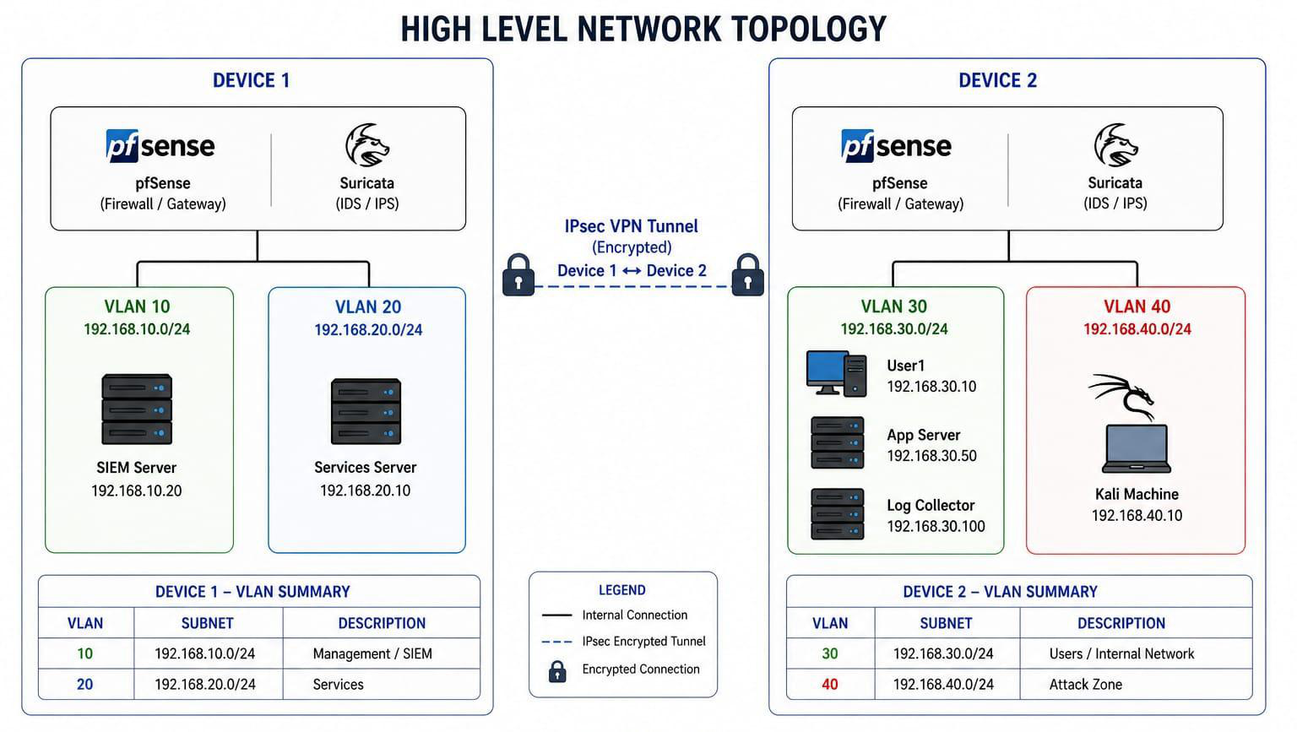
SECTION 4 · ARCHITECTURE
High-Level Network Topology
ZTA Lab — Graduation Project
9

Slide 10
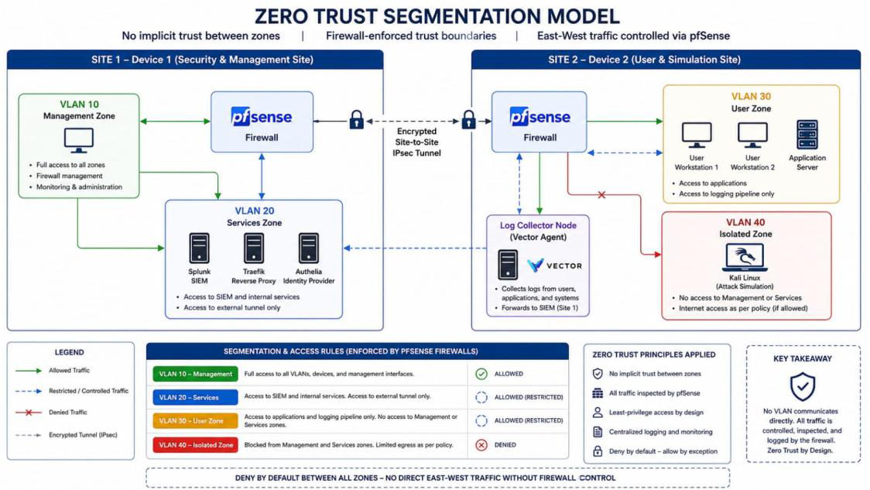
SECTION 4 · ARCHITECTURE
Zero Trust Segmentation Model
ZTA Lab — Graduation Project
10

Slide 11
SECTION 4 · ARCHITECTURE
Firewall Policy Between Zones
Default-deny, allow-by-exception — every flow not listed here is silently dropped by pfSense.
VLAN 10 → Any
ALLOW
VLAN 20 → VLAN 10
ALLOW
VLAN 30 → VLAN 10
ALLOW
Management has full network reach
Traefik routes to Splunk backend
Log forwarding via HEC over IPsec
VLAN 40 → VLAN 10
BLOCK
VLAN 40 → VLAN 20
BLOCK
VLAN 40 → VLAN 30
ALLOW
Isolated zone restricted from SIEM
Restricted from access enforcement
Controlled access for attack simulation
ZTA Lab — Graduation Project
11

Slide 12
SECTION 5 · ACCESS CONTROL
Three Independent Enforcement Layers
A failure at any single layer terminates the request — no single point of bypass.
Layer 1
Layer 2
Layer 3
Cloudflare Edge
>
Traefik Reverse Proxy
>
Authelia MFA
Identity allowlist, geo-restriction (Egypt only), WARP device posture, 4 custom WAF rules, rate limiting 30 req/10s
Policy Enforcement Point. forwardAuth middleware on every route; file-based provider for stability
TOTP required, 8h max session, 30min inactivity timeout, 3 fails → 30min lockout, default deny
ZTA Lab — Graduation Project
12

Slide 13
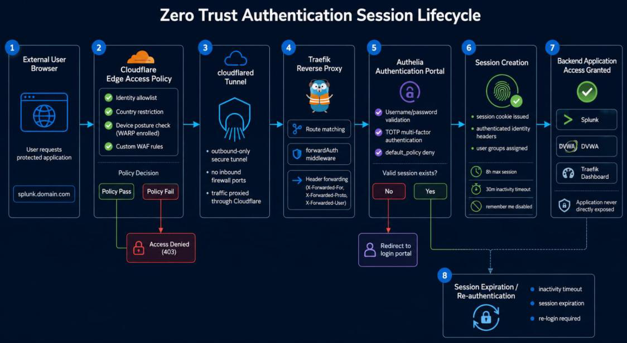
SECTION 5 · ACCESS CONTROL
Authentication Session Lifecycle
Authelia Parameters
MFA method: TOTP
Session max: 8 hours
Inactivity timeout: 30 minutes
Lockout: 3 fails / 2 min → 30 min ban
ZTA Lab — Graduation Project
13

Slide 14
SECTION 6 · TELEMETRY & SIEM
Log Collection & Enrichment Pipeline
01 Collect
02 Filter
03 Enrich
04 Deliver
7 sources: syslog, auditd, pfSense filterlog, Suricata EVE JSON, journald, Docker, Authelia audit
>
Drop CRON, apt/dpkg, NTP sync, NetworkManager, snapd noise — 85% volume reduction
>
Add structured fields: auth_event, ssh.src_ip, sudo.cmd, alert_sig, firewall.action
>
Vector D1 + D2 → Splunk HEC (TCP 8088), D2 traffic over encrypted IPsec tunnel
7
15+
85%
500MB/day
log sources
enriched fields
noise reduced
Splunk Free cap
ZTA Lab — Graduation Project
14

Slide 15

SECTION 6 · TELEMETRY & SIEM
Encrypted Cross-Site Log Delivery
Log data from Device 2 is transmitted to Splunk on Device 1 exclusively over the IKEv2 IPsec tunnel — keeping log delivery isolated from application traffic and off any unencrypted path.
Cipher
AES-CBC (256-bit)
Phase 1 & Phase 2 Established
pfSense Status confirms live tunnel traffic with active byte/packet counters on both sites.
Integrity
HMAC-SHA2-256-128
PRF
PRF-HMAC-SHA2-256
Design rationale
Key Exchange
MODP-2048 (DH Group 14)
Prevents log traffic from traversing an unencrypted path; isolates delivery from application traffic between sites.
ZTA Lab — Graduation Project
15

Slide 16
SECTION 7 · ATTACK SIMULATION
Multi-Phase Kill-Chain (full_killchain.sh)
Executed from kali-vm (192.168.40.10) against authorized targets in VLAN 30 — producing real traffic that exercises the full detection pipeline.
1
2
3
4
5
6
7
8
9
Reconnaissance
Web Fingerprint
SSH Brute Force
SQL Injection
Valid Access
Privilege Escalation
Persistence
Credential Access
Evasion
nmap -sS
nikto / gobuster
hydra
sqlmap
ssh alice@...
sudo bash
systemd backdoor
cat /etc/shadow
unset HISTFILE
T1046
T1592
T1110.001
T1190
T1078
T1548.003
T1543.002
T1003.008
T1070.003
16 MITRE ATT&CK techniques mapped end-to-end
From initial reconnaissance (T1046) through persistence (T1543.002) to indicator removal (T1070.003) — exercising every layer of the detection pipeline.
ZTA Lab — Graduation Project
16

Slide 17
SECTION 7 · ATTACK SIMULATION
Detection Engineering — Example Rules
DETECTION 1
DETECTION 2
DETECTION 3
SSH Brute Force
Privileged Sudo Execution
Geographic Policy Violation
T1110.001
T1548.003
Aggregate failed SSH attempts per source IP/host over 10-min window. Fire ≥5, escalate CRITICAL ≥20.
Fire on any sudo execution where target user is root. Enriched with sudo.cmd for analyst review.
Identify HTTP 403 from custom geo WAF expression; correlate source country vs. allowlist.
Observed in Splunk
Observed in Splunk
Observed in Splunk
77,594 events observed from 192.168.40.10
alice escalated to root → systemd backdoor created
France access attempt blocked at Cloudflare edge
ZTA Lab — Graduation Project
17

Slide 18
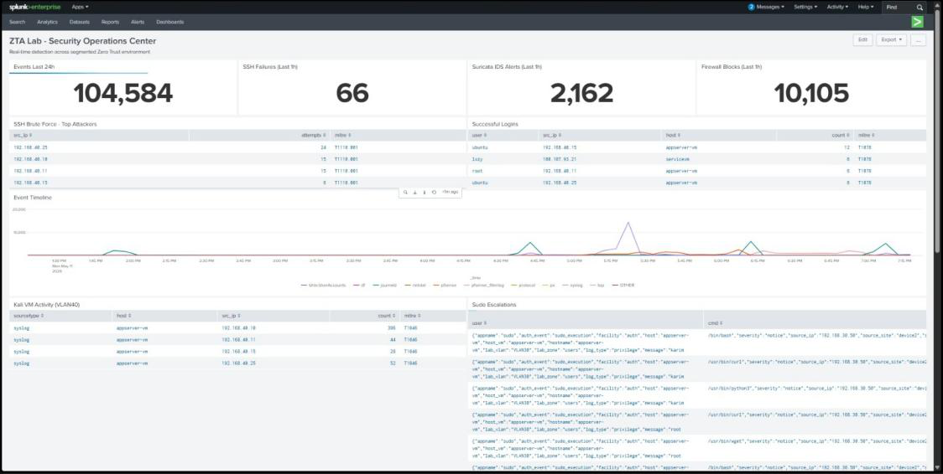
ZTA Lab — Live System
SPLUNK · SECURITY OPERATIONS CENTER
104,584
66
2,162
10,105
Events in 24h
SSH Failures
Suricata IDS Alerts
Firewall Blocks

Slide 19
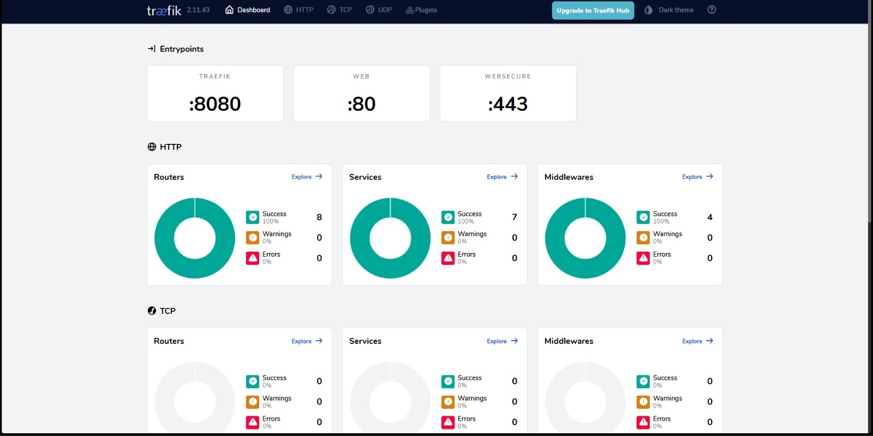
LAYER 2 — POLICY ENFORCEMENT POINT
Traefik Reverse Proxy
8 Routers · 7 Services · 4 Middlewares · 100% success
ZTA Lab — Graduation Project

Slide 20
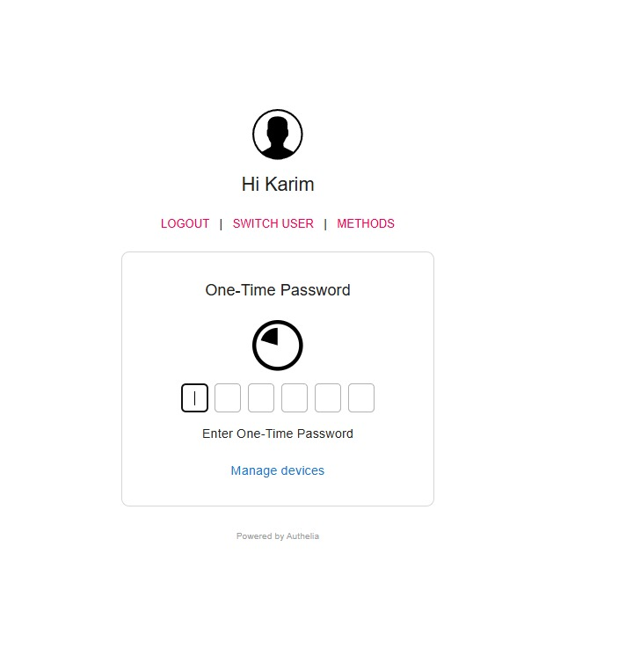
LAYER 3 — MULTI-FACTOR AUTHENTICATION
Authelia TOTP Prompt
Session granted only after valid TOTP code — user 'karim'
ZTA Lab — Graduation Project

Slide 21
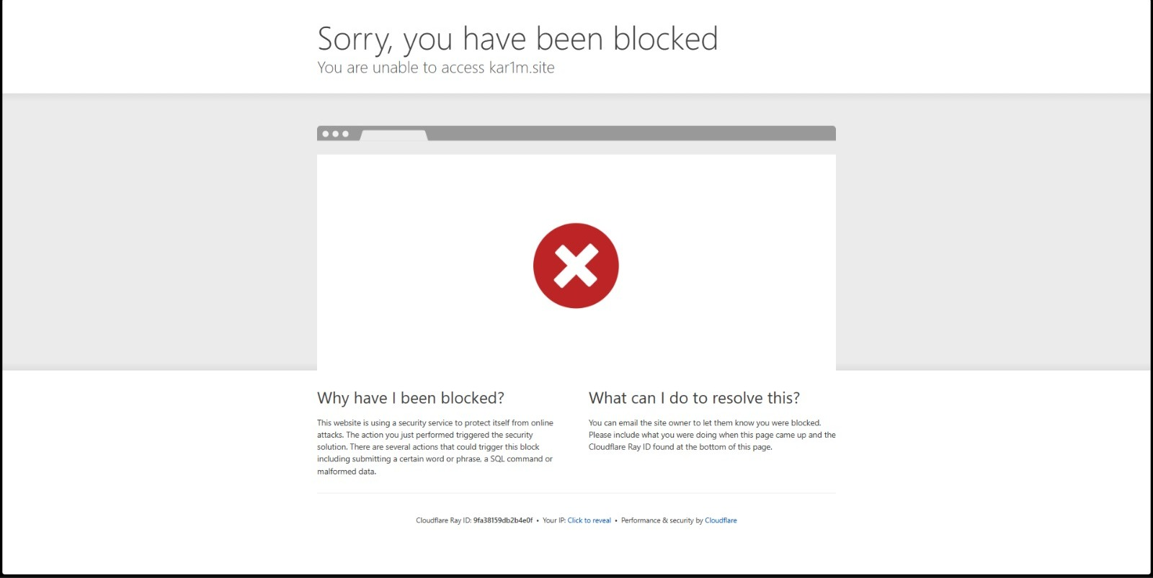
LAYER 1 — EDGE ACCESS POLICY
Cloudflare Geo-Restriction
Access from France → HTTP 403 before reaching the tunnel
ZTA Lab — Graduation Project

Slide 22

SECTION 8 · VALIDATION
Testing & Quality Assurance
Functional Validation — 7 / 7 Passed
Adversarial Scenarios — 7 / 7 Confirmed
VLAN 40 → siem-vm
Connection timed out
Nmap scan VLAN10 from VLAN40
All ports filtered; deny logged
External access, no WARP
HTTP 403
Hydra SSH brute force
Detection fired as expected
Access from outside Egypt
Cloudflare block page
sqlmap via external domain
Blocked at edge — HTTP 403
Authelia login, no valid TOTP
Login refused
Repeated failed TOTP
Account locked, 30-min ban
Route w/ no Authelia policy
HTTP 403 from Traefik
systemd backdoor creation
T1543.002 evidence in Splunk
Key operational lesson: warp-svc log noise
Cloudflare WARP daemon on appserver-vm generates large diagnostic payloads not covered by the current VRL noise filter — consuming Splunk ingestion budget without security value. Lesson: extend the noise filter to include appname == 'warp-svc'.
ZTA Lab — Graduation Project
18

Slide 23
SECTION 8 · VALIDATION
NIST SP 800-207 Principles & Key Metrics
Principles Applied
Project Metrics at a Glance
No implicit trust — All requests pass Cloudflare → Traefik → Authelia
2
8
4
7
Per-session access — TOTP required; 8h max, 30m inactivity
Physical machines
Virtual machines
VLANs / trust zones
Log sources
Dynamic policy — Identity, geo & posture evaluated per request
85%
16
10
7/7
Continuous monitoring — Vector + Splunk real-time across all zones
Volume reduction
MITRE techniques
Detection rules
Tests passed
Least privilege — Default-deny between zones; undeclared routes blocked
ZTA Lab — Graduation Project
19

Slide 24
SECTION 8 · VALIDATION
Known Limitations
No EDR/XDR platform
Linux-only environment
Endpoint visibility relies on auditd + rsyslog only
AD, NTLM, Kerberos remain untested
No SOAR automation
Splunk Free ingestion cap
Alert response is manual; no auto-containment
500 MB/day constrains retention & high-volume tests
Detection rules are prototypes
Cloudflare trust concentration
Not tuned against sustained production-volume data
Edge enforcement depends on Cloudflare account integrity
ZTA Lab — Graduation Project
20

Slide 25
CONCLUSIONS
Five Engineering Domains, One Coherent System
Network Architecture — Trust zones enforced at the firewall, not assumed from position
Technology Stack
Identity & Access Control — 3-layer enforcement chain validated independently at each layer
• Splunk 9.3.2
• Vector 0.55.0
Telemetry Engineering — Heterogeneous sources normalized, filtered, delivered encrypted
• Traefik v2.11
• Authelia
Detection Design — SPL rules against structured fields, not raw text
• pfSense 2.7
Operational Troubleshooting — Cross-layer diagnosis of silent multi-component failures
• Suricata
• Cloudflare Zero Trust
• Docker
Each control is necessary but insufficient alone — the system's coherence depends on the correct integration of all layers together.
• Ubuntu 22.04/24.04
• Kali Linux 2024
• VirtualBox / Win11
ZTA Lab — Graduation Project
21

Slide 26
ROADMAP
What's Next
Near-term
Medium-term
Long-term
Splunk UF on services-vm for Docker visibility
Windows Server VM for AD scenarios
Replace Splunk Free with Elastic
FIM across all VMs
Expand SPL library w/ ATT&CK heatmap
SOAR integration (n8n / Shuffle)
Automated abuse.ch C2 blocklist refresh
Structured per-app access policy docs
Formal detection rule tuning at scale
ZTA Lab — Graduation Project
22

Slide 27
Thank You
Questions & Discussion
Zero Trust Architecture Lab — Information Security Analyst (GIZA_ISS6_S1)
Karim Abdel-Nasser Rady · Mohamed Mamdouh · Donia Abd Elnasser Mohamed · Hoda Khaled Essam Eldin Mansour · Ali Ashraf Ali Mehanna · Mohamed Adel
Supervised by Eng. Mohamed Seed

